Slide 1
Review
What have we learned so far?
Area under curve, Rieman sums (LHS,RHS,…)
Approx. integration (Simpson’s Rule)
FTC (derivative/integral)
Indefinite / Definite integrals
How were the quiz averages?
HWQ1 = 89%
FSQ1 = 84% (however, some 0’s brought things down)
DR= 82% (however, some 0’s brought things down)

Slide 2
Math 152 – Lesson 7
Lesson | Topic | Reading
6 | Indefinite Integrals & NCT | 5.4
7 | Substitution Rule | 5.5
8 | Areas Between Curves | 6.1
Objectives:
Show how the SUBSTITUTION RULE for integration is related to the CHAIN RULE
Recognize when to use the substitution rule
Evaluate integrals using the substitution rule
Recognize & apply properties of symmetric functions

Slide 3
The Substitution Rule
Why? FTC doesn’t always help us:
Simplify by letting: u = 1 + x² and du = 2xdx
Check answer:

Slide 4
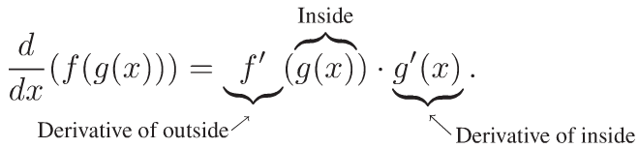
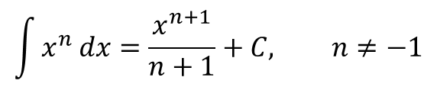
“Undoing” The Chain Rule
$\frac{d}{dx} sin⁡(x^{3})$ = cos($x^{3})∙3x^{2}$
Notes:
If it looks like a product of the chain rule….

Slide 5
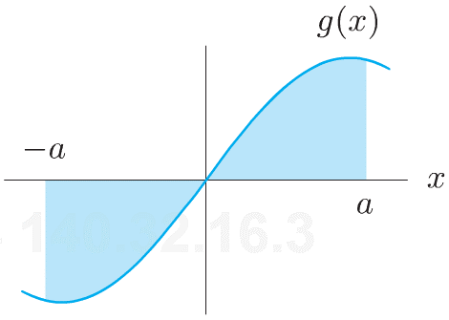
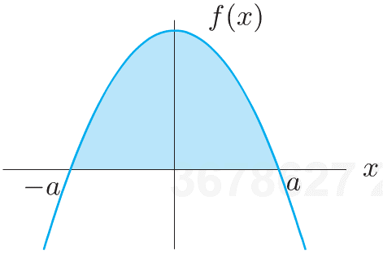
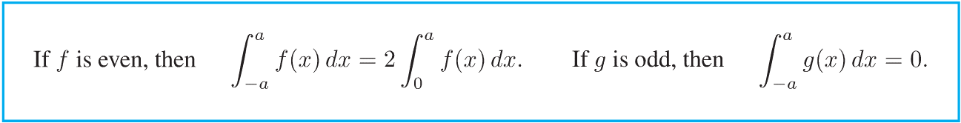
Symmetry
Notes:
Why important? If you know odd/even, you automatically know something about the derivative.

Slide 6

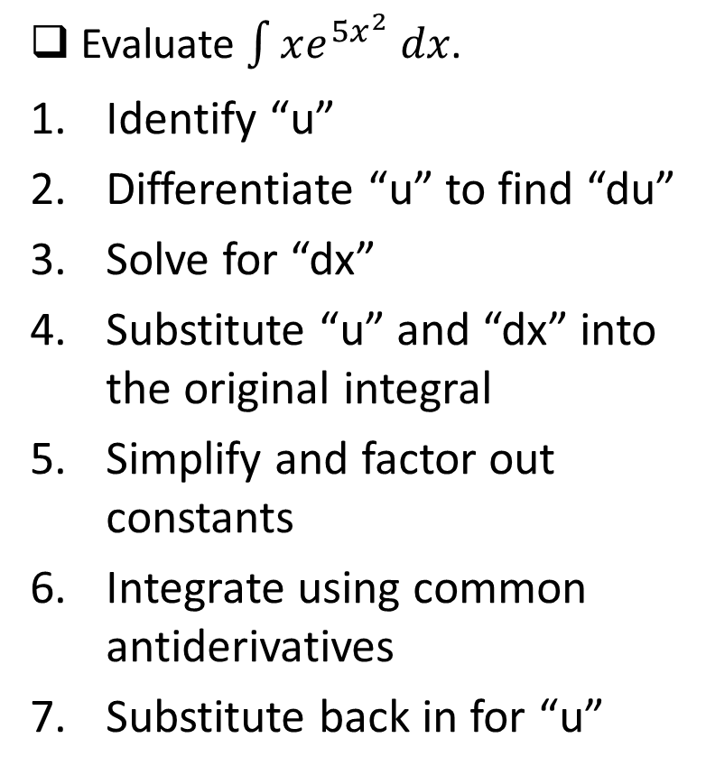
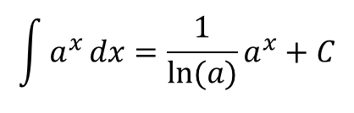
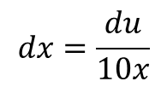

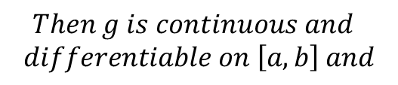

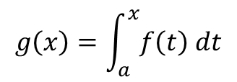
Steps to Integration by Substitution
Evaluate $\int{xe^{{5x}^{2}} dx}$.
Identify “u”
Differentiate “u” to find “du”
Solve for “dx”
Substitute “u” and “dx” into the original integral
Simplify and factor out constants
Integrate using common antiderivatives
Substitute back in for “u”
$$u=5x^{2}$$
$$du=10x dx$$
$$dx=\frac{du}{10x}$$
$$\int{xe^{u}\frac{du}{10x}}$$
$$\frac{1}{10}\int{e^{u} du}$$
$$\frac{1}{10}e^{u}+C$$
$$\frac{1}{10}e^{5x^{2}}+C$$
Notes:
Suggested steps…except for #7—you MUST re-substitute the $5x^{2}$ for “u”
It’s called “u-substitution”, but if the original variable is “u”, then pick something else…like “x”
What would happen if you picked the “wrong” “u” value?
Ie, u = e^(5x^2)?

Slide 7
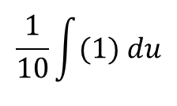
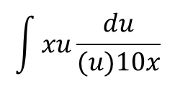
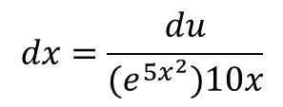


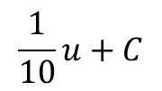
Steps to Integration by Substitution
Evaluate $\int{xe^{{5x}^{2}} dx}$.
Identify “u”
Differentiate “u” to find “du”
Solve for “dx”
Substitute “u” and “dx” into the original integral
Simplify and factor out constants
Integrate using common antiderivatives
Substitute back in for “u”
$$u=e^{{5x}^{2}}$$
$$du=(e^{{5x}^{2}})10x dx$$
$$dx=\frac{du}{(e^{{5x}^{2}})10x}$$
$$\int{xu\frac{du}{(u)10x}}$$
$$\frac{1}{10}\int{(1) du}$$
$$\frac{1}{10}u+C$$
$$\frac{1}{10}e^{5x^{2}}+C$$
Notes:
#7—you MUST re-substitute the $e^{{5x}^{2}}$ for “u”
BL: there is more than one way to skin a cat

Slide 8
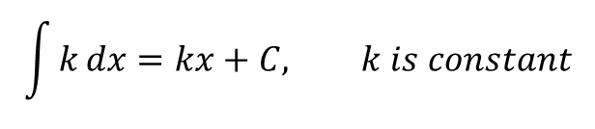
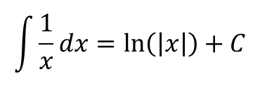
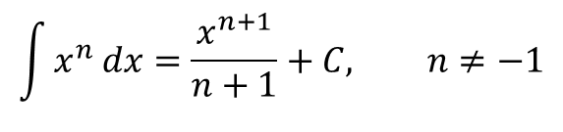
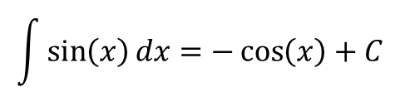
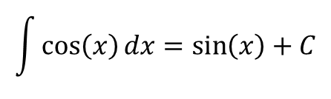
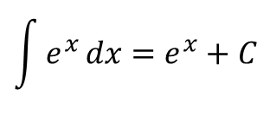
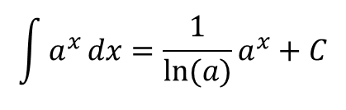
Common Antiderivatives
$$\int{k}dx=kx+C, k is constant$$
$$\int{x^{n}}dx=\frac{x^{n+1}}{n+1}+C, n≠−1$$
$$\int{\frac{1}{x}}dx=\ln\left(\left|x\right|\right)+C$$
$$\int{a^{x}}dx={\frac{1}{\ln{(a)}}a}^{x}+C$$
$$\int{e^{x}}dx=e^{x}+C$$
$$\int{\cos\left(x\right)}dx=\sin\left(x\right)+C$$
$$\int{\sin\left(x\right)}dx=−\cos\left(x\right)+C$$
Notes:
Questions:
What about $\int{{(−a}^{x})}dx$? Factor out the counstant, (-1)
What about $\int{{(−a)}^{x}}dx? Illegal. Ref section 1.5…."where ′a′ is a positive constant…′$ different than “non-negative”
p 53, laws of exponents

